Slide 1
BOM Kendriya Vihar 2
welcomes
AOA Members
for
Special General Body Meeting
17th December/ 24th December 2023
Community Center 1 (Ground Floor)

Slide 2
AGENDA POINTS OF SGBM 2023
SGBM 2023.1 To consider and dispose of the points of Special Audit Report for the period from Financial Year 2014-2015 to 2018-2019.
SGBM 2023.2 To finalize the work order for Lifts along with decision for replacement of remaining 24 lifts.
SGBM 2023.3 To finalize the election schedule and appointment of Returning Officer.
SGBM 2023.4 To reconsider the process of automatic enhancement of Subscription Charges from April every year.
SGBM 2023.5 To constitute a committee for monitoring of Infrastructure fund utilization and work related with this fund.
SGBM 2023.6 To propose the action on members working against the interest of Apartment Owners’ Association.

Slide 3
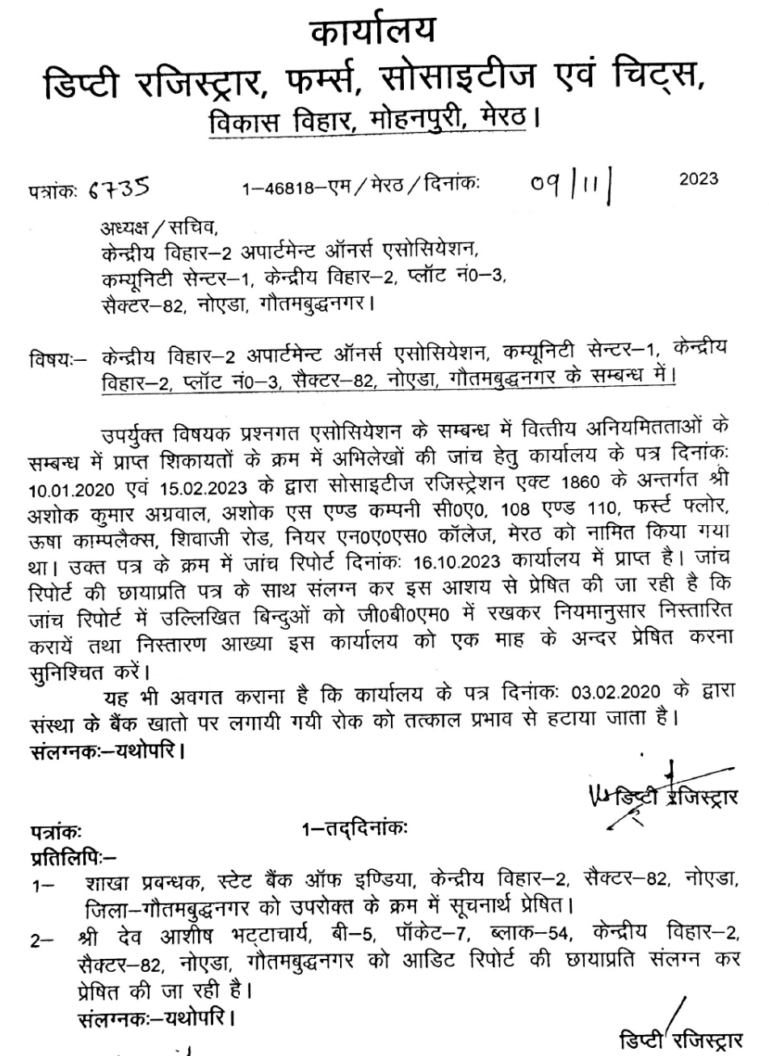
SGBM 2023.1 To consider and dispose of the points of Audit Report for the period from Financial Year 2014-2015 to 2018-2019.

Slide 4
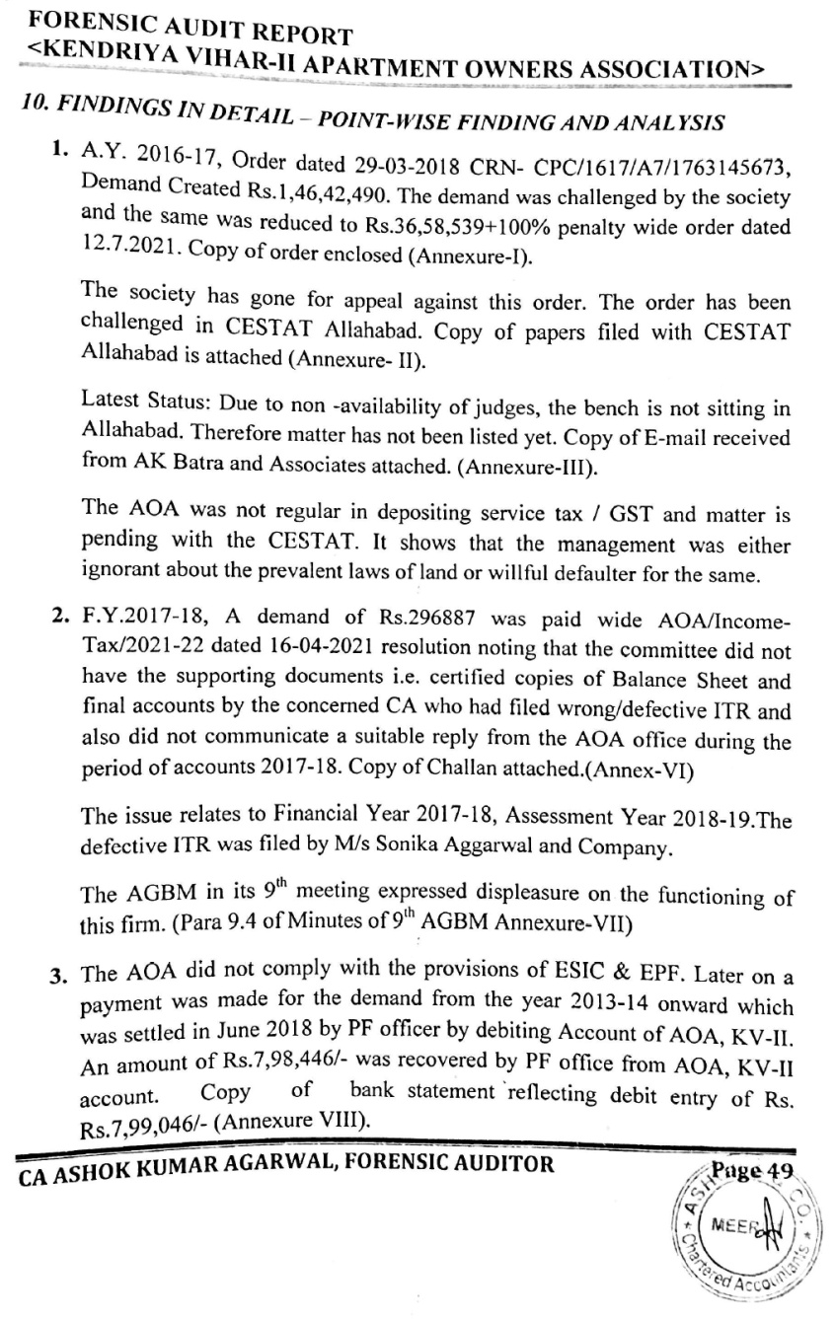
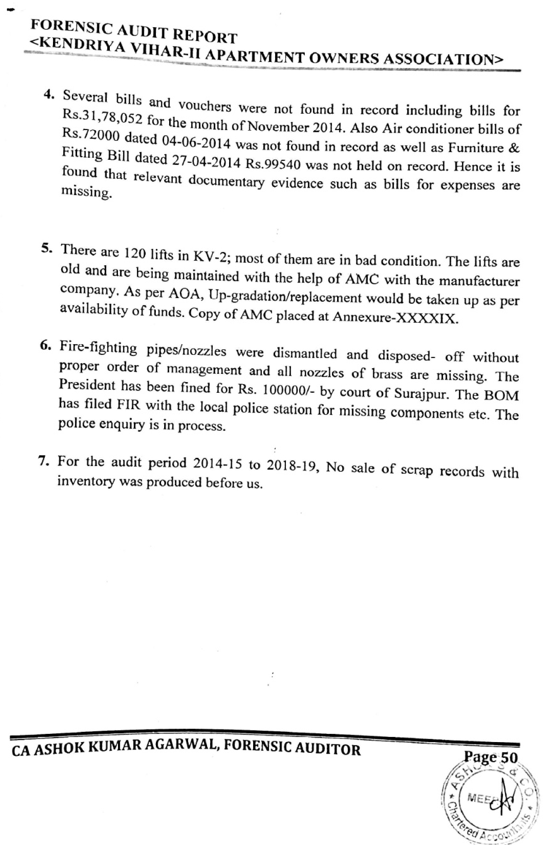
Audit Report for the period from Financial Year 2014-2015 to 2018-2019 Submitted by CA Ashok Kumar Agarwal

Slide 5
Audit Report for the period from Financial Year 2014-2015 to 2018-2019 Submitted by CA Ashok Kumar Agarwal Contd………
1. A.Y. 2016-17, Order dated 29-03-2018 CRN- CPC/1617/A7/1763145673, Demand Created Rs.1,46,42,490. The demand was challenged by the society and the same was reduced to Rs.36,58,539+100% penalty wide order dated 12.7.2021. The society has gone for appeal against this order. The order has been challenged in CESTAT Allahabad.
Latest Status: Due to non -availability of judges, the bench is not sitting in Allahabad. Therefore matter has not been listed yet.
Remarks of Auditor: The AOA was not regular in depositing service tax / GST and matter is pending with the CESTAT. It shows that the management was either ignorant about the prevalent laws of land or willful defaulter for the same.
BOM Response: The case is to be rigorously pursued with CETSTAT
SGBM Decision: The case should be rigorously pursued with CETSTAT

Slide 6
Audit Report for the period from Financial Year 2014-2015 to 2018-2019 Submitted by CA Ashok Kumar Agarwal Contd………
2. F.Y.2017-18, A demand of Rs.296887 was paid wide AOA/Income- Tax/2021-22 dated 16-04-2021 resolution noting that the committee did not have the supporting documents i.e. certified copies of Balance Sheet and final accounts by the concerned CA who had filed wrong/defective ITR and also did not communicate a suitable reply from the AOA office during the period of accounts 2017-18. The issue relates to Financial Year 2017-18, Assessment Year 2018-19.The defective ITR was filed by M/s Sonika Aggarwal and Company.
The AGBM in its 9th meeting expressed displeasure on the functioning of this firm.
BOM Response: No further action on part of BOM as there is no adverse remark from the Auditor, further the services of M/s Sonika Agarwal & Co, was terminated by respective BOM.
SGBM Decision: SGBM endorses the decision of BOM and as per information furnished by members of respective BOM, it was noted that this pertain to F.Y. 2016-2017

Slide 7
Audit Report for the period from Financial Year 2014-2015 to 2018-2019 Submitted by CA Ashok Kumar Agarwal Contd………
3. The AOA did not comply with the provisions of ESIC & EPF. Later on a payment was made for the demand from the year 2013-14 onward which was settled in June 2018 by PF officer by debiting Account of AOA, KV-II. An amount of Rs.7,98,446/- was recovered by PF office from AOA, KV-II. Copy of bank statement reflecting debit entry of Rs. Rs.7,99,446/.
BOM Response: It is a statement of fact. No further action on BOM side.
SGBM Decision: It is a statement of fact. No further action

Slide 8
Audit Report for the period from Financial Year 2014-2015 to 2018-2019 Submitted by CA Ashok Kumar Agarwal Contd………
4. Several bills and vouchers were not found in record including bills for Rs.31,78,052 for the month of November 2014. Also Air conditioner bills of Rs.72000 dated 04-06-2014 was not found in record as well as Furniture & Fitting Bill dated 27-04-2014 Rs.99540 was not held on record. Hence it is found that relevant documentary evidence such as bills for expenses are missing.
BOM Response: BOM has already informed the police in writing regarding missing items. The matter would be pursued further with police.
SGBM Decision: Proper entry of air conditioner and furniture expenses were found in the audit report of 2014-2015 and was passed by respective GBM. Proper record should be maintained and digitalized in future.

Slide 9
Audit Report for the period from Financial Year 2014-2015 to 2018-2019 Submitted by CA Ashok Kumar Agarwal Contd………
5. There are 120 lifts in KV-2; most of them are in bad condition. The lifts are old and are being maintained with the help of AMC with the manufacturer company. As per AOA, Up-gradation/replacement would be taken up as per availability of funds.
BOM Response: It is a statement of fact. No further action on BOM side.
SGBM Decision: 10th GBM has already taken a decision on replacement / upgradation of lifts.

Slide 10
Audit Report for the period from Financial Year 2014-2015 to 2018-2019 Submitted by CA Ashok Kumar Agarwal Contd………
6. Fire-fighting pipes/nozzles were dismantled and disposed- off without proper order of management and all nozzles of brass are missing. The President has been fined for Rs. 100000/- by court of Surajpur. The BOM has filed FIR with the local police station for missing components etc. The police enquiry is in process.
BOM Response: BOM has already informed the police in writing regarding missing items. The matter would be pursued further with police.
SGBM Decision: SGBM endorses the decision of BOM and suggested to maintain the asset register properly.

Slide 11
Audit Report for the period from Financial Year 2014-2015 to 2018-2019 Submitted by CA Ashok Kumar Agarwal Contd………
7. For the audit period 2014-15 to 2018-19, No sale of scrap records with inventory was produced before us.
BOM Response: There is no record of inventory for scrap in office. However, the money received through selling of scrap is reflected in balance sheets which were presented and passed in respective GBMs. Special GBM may suggest further action which is to be taken.
SGBM Decision: Proper record is to be maintained in future.

Slide 12
Audit Report for the period from Financial Year 2014-2015 to 2018-2019 Submitted by CA Ashok Kumar Agarwal Contd………
Conclusion of Auditor: After the several reminders the management agreed for the audit/investigation as ordered by Deputy Registrar of Firms, Societies & Chits, Meerut on 28th, February, 2023 by passing a resolution in the GBM. They submitted a reply with submitting Audit report & Balance sheet for financial year 2014-15, 2017-2018 & 2018-19. However they could not hand over the books of Accounts relevant documentary evidence such as bills for expenses & details.
BOM Response:
S No | Date | Remarks
1 | 27 Feb 2023 | Formation of New BOM
2 | 06 March 2023 | Letter to Registrar for approved rates for Auditor or panel of auditors
3 | 18 March 2023 | Letter from Registrar: Appointed Ashok Agarwal as auditor on negotiated rates.
4 | 19 March 2023 | Mail to Auditor for discussion on 25th March
5 | 24 March 2023 | Mail of auditor received where he showed his inability to come and suggested for 1st week of April
6 | 04 April 2023 | Mail to auditor for meeting date and he confirmed for 11th April
7 | 12 April 2023 | To registrar regarding no response from Auditor and requested for another Auditor
8 | 19 May 2023 | Appointment of Auditor Shri Ashok Kumar Agarwal, CA
All the relevant documents, bills and books of Accounts were handed over to Auditor, except the missing documents

Slide 13
Audit Report for the period from Financial Year 2014-2015 to 2018-2019 Submitted by CA Ashok Kumar Agarwal Contd………
Conclusion of Auditor: After considering the allegations, viewing available documents, investigation, interviews and research, we are of the opinion that either old management was involved in some activities or they were ignorant about the prevalent laws of land and allegations on them are widely correct. It appears that they want to hide their misappropriation/unlawful actions and therefore, some records are missing. No particulars of action taken against the defaulting members of BOM were provided.
BOM Response: BOM has considered the remarks of auditor as quite serious and Special GBM may suggest further action which is to be taken considering the fact that all previous office bearers are also the members of AOA.
SGBM Decision: SGBM deliberated the point in detail and found that no pinpointed report on allegation has been made by the auditor on misappropriation / unlawful action.

Slide 14
SGBM 2023.2 To finalize the work order for Lifts along with decision for replacement of remaining 24 lifts.
Lift Types: Kendriya Vihar has 2 types of lifts {Type A - 5 passenger (96 including 93 OTIS and 3 TKE) & Type B - 8 passenger (24 all TKE)}
10th AGBM Decision: Proposal was for replacement of 96 lifts and up-gradation of remaining 24 lifts with an estimated cost of Rs.10.5 crores. It was also apprised to Members that replacement of one lift will take around three to four months time. Members showed their concern regarding the time taken in replacement and suggested BOM to look for alternate arrangements during replacement of lifts for elderly residents residing in all the blocks. AGBM approved the replacement/up-gradation of all 120 lifts with an estimated budget of Rs. 10.5 crores with majority.
BOM Decision: The representation from residents of Phase V staying in these 24 blocks have been officially received and BOM is of the opinion that the remaining 24 lifts which were earlier proposed to be upgraded should also be replaced.
SGBM Decision on Replacement of remaining 24 Lifts: It is unanimously passed that all 24 lifts of Phase V will also be replaced..

Slide 15
SGBM 2023.2 To finalize the work order for Lifts Contd……..
New proposed lifts will have the following features:
Microprocessor based controller with full collective/selective operation.
Machine room will be geared and gearless for Type A and Type B respectively.
Car enclosure, car & door panels will be of scratch proof stainless steel with LED lights and provision of one high resolution car camera.
Car will be with center opening (700x2000mm & 800x2000mm respectively) with braille call buttons and full height infra-red door safety & Automatic Rescue Device.
Sensor based automatic switching on-off of car cabin lights and fans.
Intercom facility.
Speed will be 0.7m/s and 1.0m/s respectively.

Slide 16
SGBM 2023.2 To finalize the work order for Lifts Contd……..
S/NO | REQUIREMENTS/CONDITIONS | EISA | OTIS | ECE
1 | Experience of executing similar work in the last 15 years with certain financial conditions | Does not meet the criteria | Meets the criteria | Meets the criteria
2 | Time Frame of completion of work within 730 days | Accepted | Accepted | Accepted
3 | Use old lift parts like guiderails with existing brackets, buffer spring and counter weight etc. | All offered parts will be retained. | Partially retaining the parts | Not using any old part
4 | Additional facilities | Nil | Overload device Anti nuisance car call protection Nudging Manual rescue operation | Overload with indicator ECE smart call Auto light cut of Manual rescue operation ERP with no additional cost Offered completion in approx 18 months

Slide 17
SGBM 2023.2 To finalize the work order for Lifts Contd……..
S/NO | REQUIREMENTS/CONDITIONS | EISA | OTIS | ECE
5 | TERMS OF PAYMENT i. 50% after initial inspection and delivery at site in good condition on prorate basis. ii. 30% after completion of installation in all respects. iii. 20% after testing, commissioning, trial run and handing over to society including inspection. | Accepted | Accepted 30% on signing of contract against bank guarantee. 60 % on delivery on prorate basis. 10% on handover on prorate basis | Accepted 30% advance against bank guarantee 50% on initial inspection and delivery on prorate basis 10% on completion of installation on prorate basis 10% on handing over on prorate basis
6 | Observations of Lift Committee | The factory is ordinary. Even the storage of different items is not there. | Visited the store as Factory of OTIS is in Bangalore. Not considered to visit factory as per its reputation | Manufacturing all possible items in their factory at Ghaziabad and found to be satisfactory.

Slide 18
SGBM 2023.2 To finalize the work order for Lifts Contd……..
S/NO | REQUIREMENTS/CONDITIONS | EISA | OTIS | ECE
7 | Cost of all 120 Lifts | Rs 6,13,93,000 + GST | Rs 12,44,70,000+ GST | RS 11,50,00,800 including GST
8 | Dismantling of old lifts and all civil works related to new lift installation including water proofing in all 120 blocks. | @ Rs 37 thousand per lift + GST Rs 44,40,000+GST | @ Rs. 2 lakhs per lift+GST Rs 2,40,00,000+GST | @ Rs 1.52 lakhs per lift including GST. Buyback after dismantling is Rs. 65000/- per lift. Rs 1,04,40,000 including GST
9 | Total Cost | 6,58,33,000 + GST | Rs 14,84,70,000/- + GST | Rs. 12,54,40,800/- including GST
10 | TOTAL COST TO SOCIETY | Rs. 7,76,82,940/- | RS. 17,51,94,600/- | Rs. 12,54,40,800/-
Committee & BOM Recommendations: ECE make is optimally suited for replacement of existing 120 lifts of Kendriya Vihar – II based on their technical specifications, infrastructure facilities, work completion time and added advantage over other available options despite of being L2.
SGBM Decision on Work Order for 120 Lifts: Order should be placed as per the recommendations of Committee and BOM. Further SGBM directed to negotiate for three year comprehensive warranty and camera. The AMC cost should also be taken from the company.

Slide 19
SGBM 2023.3: To finalize the election schedule and appointment of Returning Officer.
BOM Decision: President has suggested to appoint Shri Shashi Pal Sharma, as returning officer which was agreed upon by members. Further, it was unanimously decided that election should be conducted on 25th February 2024 (Sunday).
SGBM Decision: It is the decision of BOM and should be decided by BOM. SGBM objected on the name and advised to reconsider the name of Returning Officer.

Slide 20
SGBM 2023.4 To reconsider the process of automatic enhancement of Subscription Charges from April every year.
BOM Response: The existing arrangement of automatic enhancement of subscription charges from April every year delegates power of enhancement of subscription to BOM without holding AGBM as seen in previous years.
BOM strongly recommends that this delegation of power to BOM for automatic enhancement may be withdrawn and the decision on enhancement / reduction of subscription charges may be taken in Annual General Body Meeting as per KV-II by-laws.
SGBM Decision: SGBM unanimously agreed on it.

Slide 21
SGBM 2023.5 To constitute a committee for monitoring of Infrastructure fund utilization and work related with this fund.
BOM Response: BOM discussed the point on constitution of committee for monitoring of infrastructure fund utilization and work related with this fund in its 16th meeting held on 15th December 2023 and unanimously agreed to take it to the SGBM for taking the decision on this aspect. Further, it was proposed that at least Five (5) non BOM members should be the part of committee along with office bearers of incumbent BOM (President, Vice President, Secretary, Treasurer) and the decision should be taken by majority.
SGBM Decision: Five members committee decided by SGBM is as under:
It has been voted with majority that same penalty as in case of monthly subscription will be imposed on members for not depositing infrastructure fund.

Slide 22
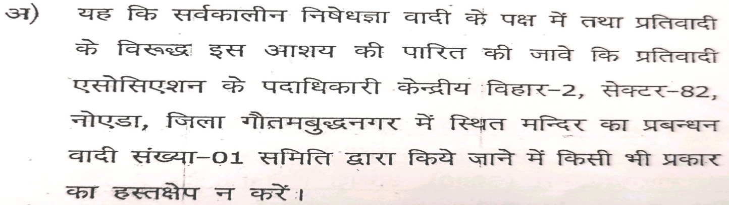
SGBM 2023.6 To propose the action on members working against the interest of Apartment Owners’ Association.
BOM Response: BOM unanimously decided to take action on the members who are working against the interest of Apartment Owners Association of KV-II by restricting such members from electoral process after getting approval from SGBM. {Ref: - UP Apartment Laws Chapter III Point 5 states that “ common area and facilities shall not, in any manner, be transferred and shall undivided. Further, no apartment owner, or any other person, shall be eligible to initiate any action for the partition or separate possession, or division of any part thereof ”}.
Decision of 10th AGBM held on 02nd July 2023:
10.13.2 To hold the election for constitution of a Committee to look after the affairs of unified temple complex.
All the Members of AOA will have the voting rights to elect a 10 member Committee.
The Committee will manage and look into all the affairs of the unified temple complex.
Petition filed by Shiv Radha Krishna Sewa Samiti having approx. 80 members of the Association:

Slide 23
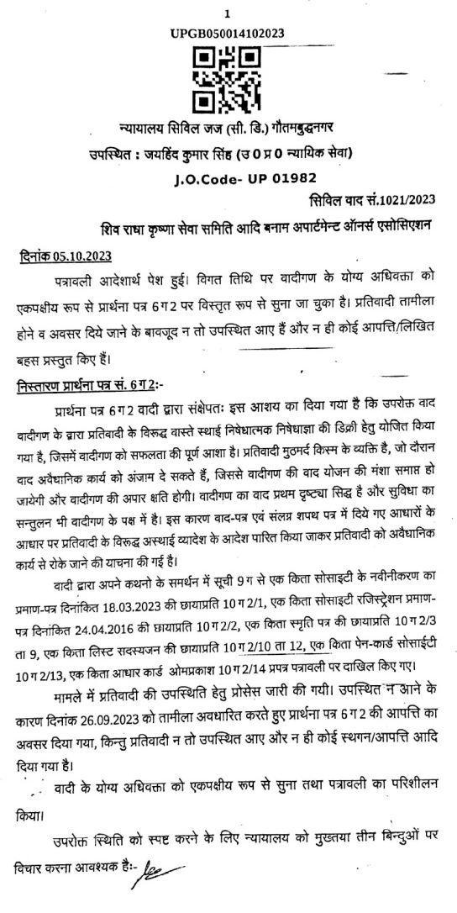
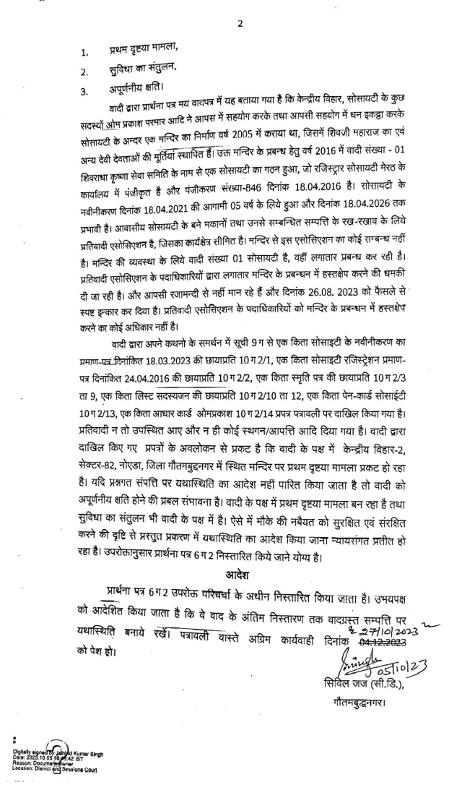
SGBM 2023.6 To propose the action on members working against the interest of Apartment Owners’ Association. Contd………
SGBM Decision: SGBM with majority decided to take action against those members by de-barring them from election process as they may misuse the office, if are elected.

Slide 24
THANKS

